Slide 1
Economic measurements

Slide 2
Test your intuition
Which SERP is better?

Slide 3
SERP one
SERP two
Good
Bad
Good
Bad
Bad
Bad
Bad
Good
Bad
Bad
Bad
Bad
Notes:
An easy warmup for people who need warming up

Slide 4
SERP one
SERP two
Good
Good
Good
Good
Bad
Bad
Bad
Good
Bad
Bad
Bad
Bad
Notes:
Two is at least as good as one
RR says they’re the same

Slide 5
SERP one
SERP two
Bad
Good
Bad
Bad
Bad
Bad
Good
Bad
Good
Bad
Good
Bad
Notes:
P differs to RR for example
Depends on the searcher’s goal

Slide 6
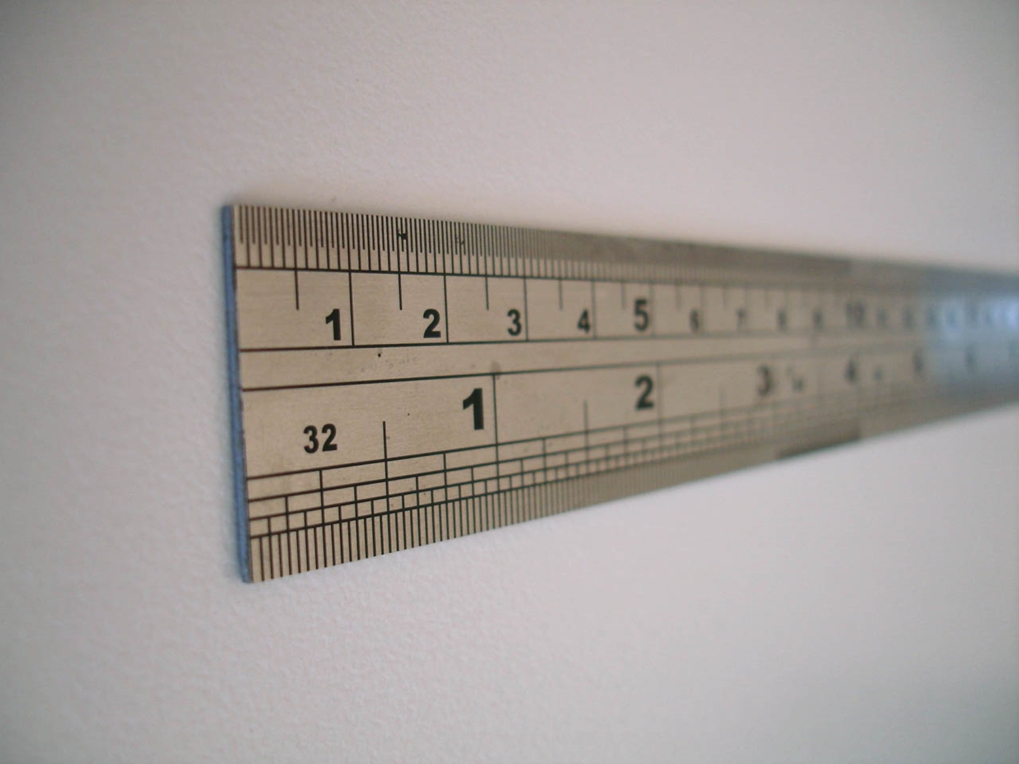
Measuring a SERP: “offline”/“test collection” metrics

Slide 7
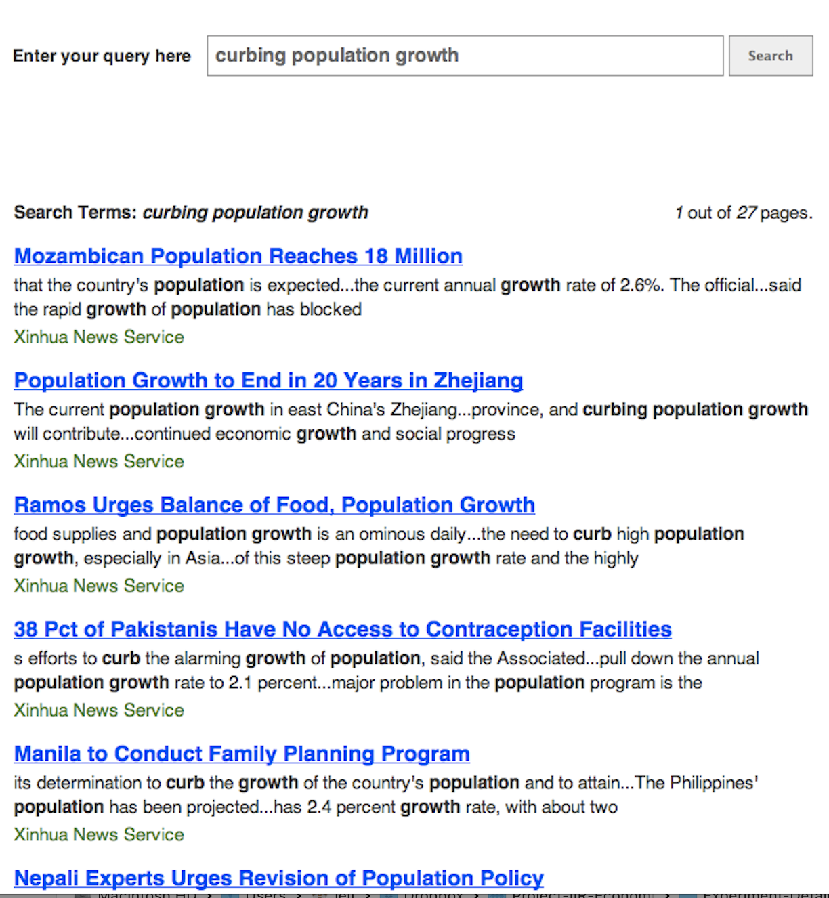






Bad
Bad
Good
Fair
Good
Weight
×
Gain
Notes:
Here’s an example
A list of results
Each has some value – NB we are using “gain” and “utility” interchangeably
User reads down a homogeneous list, less importance/attention to each thing in turn – this is our model
Multiply, that’s our metric

Slide 8
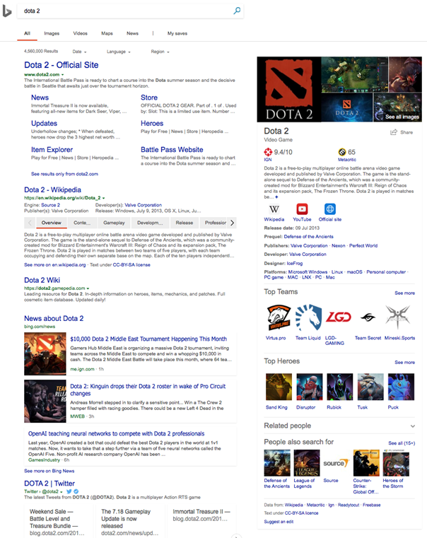
☛
sort of
approximates
☛
Ranked list, top down
Web SERP
Homogenous elements
Notes:
Of course we don’t represent the SERP, just a list of results (URLs)
Because the list of URLs stands for the SERP, the metric somehow stands for the experience
(or the getting-relevant-info part of it)

Slide 9
Why offline?
Cheap
Fast
Repeatable
Tells us about the real experience
?
Notes:
Good for repeated experimentation
We use them ‘cause we believe they have external validity; that is, that they tell us what the real experience would be like; they predict some aspect of the searchers’ experience
They are only as good as they are valid

Slide 10
RBP: geometrically-decreasing importance
P@k: fraction of the top k which are relevant
RR: 1 / rank of the first relevant result
nDCG: logarithmically-decreasing importance
AP: average of precision values, at positions where there’s relevance
INST, TBG, ERR, U-measure, Bejewelled, bpref, INSQ, …
Notes:
There are lots!
Many in use e.g. at TREC, in SIGIR papers; many many perpetrated in the literature (some by us)
And they all seem to have different units – more on this later
Lots of metrics: anything in common, any coherent way to talk about these?
Any way to discuss, trade off, choose?
Yes: examine the model underlying each

Slide 11



“a deliberate simplification of something complicated with the objective of making it more tractable” Frigg and Hartmann, 2018. “Models in science”, in The Stanford Encyclopedia of Philosophy. Frigg, Roman and Hartmann, Stephan, 2018. “Models in Science”, in The Stanford Encyclopedia of Philosophy.
“a physical, conceptual, or mathematical representation of a real phenomenon that is difficult to observe directly” Rogers, 2012. “Scientific modeling”, in Encyclopædia Britannica.
“A simplified description, especially a mathematical one, of a system or process, to assist calculations and predictions” OED, 2019.
Notes:
What is a model?
A simplification of what goes on in someone’s head when they use a SERP, and the value they take from it
Which of course we can’t observe even in principle
And which we’ll use to make predictions

Slide 12
Property
Behaviour
Value
Value judgement
Online
Offline
Notes:
A bit more concrete
A not-very-grand unified theory of searcher models for IR evaluation
Online metrics: observe behaviour and use this to predict some aspect, or property, of the SERP or the session or the item; e.g. click predicts relevance, quick back predicts non-relevance, requery predicts poor SERP
Offline: use some aspect, or property, to predict behaviour; e.g. click models

Slide 13
Property
Behaviour
Value
Value judgement
Value judgement
Online
Offline
Notes:
Then there’s another part: we assign value to these behaviours+properties; e.g. we say that a (SAT) click is good, and two clicks are twice as good; or a click on spam is bad; or more time on the SERP is bad; or etc

Slide 14
Property
Predicted behaviour
Metric
Value judgement
Online
User model
Notes:
But in practice these are instincts, or if you prefer they are matters of policy
So this is what we have for analysis: the user model is the thing that links the two
For offline metrics it’s the thing that tells us, given a SERP with some properties – or a list of things each with some properties – what we think a searcher will do
And the metric is the thing that gives you a number saying how well you’ve done
In practice the value judgements are pretty much the same: accumulating relevant information is good, simple as that
So what’s different from one metric to the next is the user model

Slide 15

Metrics from models: the C/W/L framework
Pronounced “cool”
Notes:
So is there a way to talk coherently about these models?
Yes!, of course there is, it’s CWL

Slide 16


Metrics encode models
Bad
Bad
Good
Fair
Good
Notes:
Implicitly or explicitly
Model of RPB: people read from the top, less chance of paying attention as they go down regardless of relevance
Model of P@k: people read from the top, defo pay attention to everything until they get to k
Turns out most common metrics are: read from the top, and stop at some point

Slide 17

C: continue
Given that I’m looking at rank $i$;
What is the probability that I’ll continue to rank $i+1$?
$$C_{i}=Pr(\text{continue} \text{to} i+1 | \text{looking} \text{at} i)$$
This completely defines a metric!

Slide 18
C: continue
Precision at k=5
RBP, φ=0.6
Notes:
Static models/metrics say the user’s behaviour doesn’t depend on the SERP

Slide 19
C: continue
Reciprocal rank
INST, T=1
Relevant result at rank 3
Relevant result at rank 3
Notes:
Adaptive models/metrics depend on where the relevance is

Slide 20

W: weight
$$W_{i}=\frac{\prod_{j=1}^{i−1}{C_{j}}}{\sum_{k}{\prod_{j=1}^{k−1}{C_{j}}}}$$
Notes:
C completely defines a metric
AS AN ASIDE we can show this with the W part of C/W/L
…familiar discount curves etc…

Slide 21
W: weight
Precision at k=5
RBP, φ=0.6

Slide 22
∑
weights
×
gains
= Expected gain per examination
Bad
Bad
Good
Fair
Good
Notes:
and W.r is the "usual" metric
NB units: we can talk about E(gain per inspection) BUT ALSO total gain, etc etc - NB we need to be consistent in naming here
can even include costs explicitly (not as #docs), e.g. TBG, Bejeezus?, IFT, ...

Slide 23
W∙r
= Expected rate of gain

Slide 24
Precision at k=5
RBP, φ=0.6
W = (⅕, ⅕, ⅕, ⅕, ⅕, 0…)
r = (0, 0, 1, 1, 1, 0 …)
W.r = 0 + 0 + ⅕ + ⅕ + ⅕ + 0…
W.r = ⅗
W = (.4, .24, .14, .09, .05, .03…)
r = (0, 0, 1, 1, 1, 0…)
W.r = 0 + 0 + .14 + .09 + .05 + 0…
W.r = .28, residual .08
Notes:
It really works! C → W, then the inner product of W and r is the metric – for lots and lots of metrics we use in IR eval

Slide 25
RR
INST, T=1
W = (⅓, ⅓, ⅓, 0, 0, 0…)
r = (0, 0, 1, 1, 1, 0 …)
W.r = 0 + 0 + ⅓ + 0 + 0 + 0…
W.r = ⅓
W = (.47, .21, .12, .07, .04, .02…)
r = (0, 0, 1, 1, 1, 0…)
W.r = 0 + 0 + .12 + .07 + .04 + 0…
W.r = .22, residual .05

Slide 26

L: last view
$$L_{i}=\left(\prod_{j=1}^{i−1}{C_{j} }\right)\left(1−C_{i}\right)$$
Notes:
Continue past everything earlier; then stop
NB this turns out to be a probability distribution…!

Slide 27
L: last view
Precision at k=5
RBP, φ=0.6

Slide 28

$$\sum_{i}{\left(L_{i}\sum_{j=1}^{i}{r_{j}}\right)}$$
= Expected total utility, ETU
Notes:
Then we can talk about the total gain over the whole SERP

Slide 29
W∙k
= Expected rate of cost
Notes:
If we have a cost vector k we can also talk about cost/document, expected total cost

Slide 30

$$\sum_{i}{\left(L_{i}\sum_{j=1}^{i}{k_{j}}\right)}$$
= Expected total cost

Slide 31

$$\sum_{i}{i\left(\prod_{j=1}^{i−1}{C_{j}}\right)\left(1−C_{i}\right)} \text{or} \frac{1}{W_{1}}$$
= Expected depth

Slide 32
C
Continue
W
Weight
L
Last
Notes:
C completely defines a metric
Lets us (makes us) think about what C “should” look like, i.e. what we think does make someone keep reading or stop reading

Slide 33
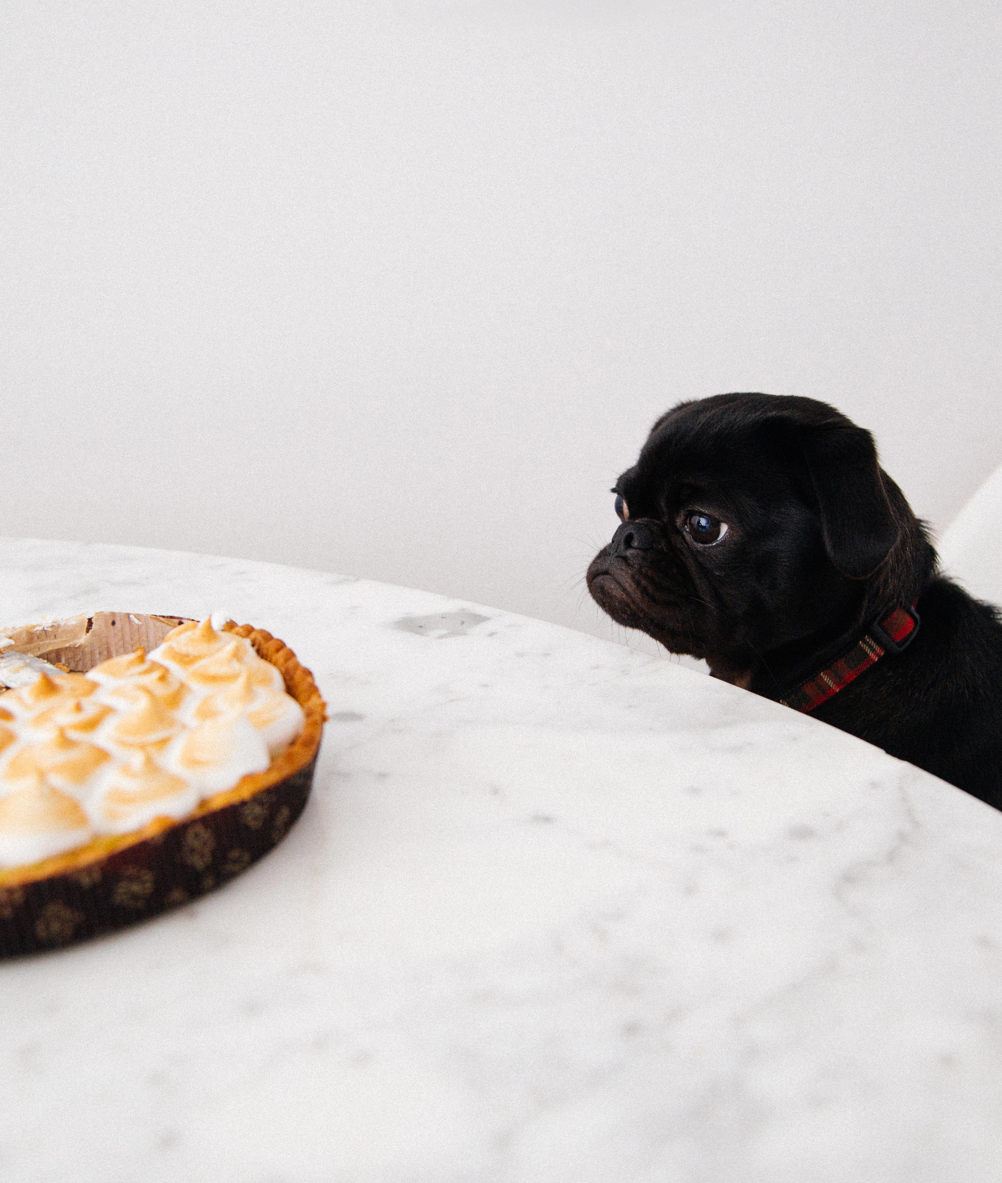
Properties of models: What do we want?
Notes:
NB for all of these we should tie back to LA/GZ's slides: here are some things they've discussed earlier, and we can turn them into constraints on the shape of C

Slide 34
Top-weighted
Searchers pay more attention to things at the top;
therefore, W is non-increasing.
(This is enforced by the C/W/L framework.)

Slide 35
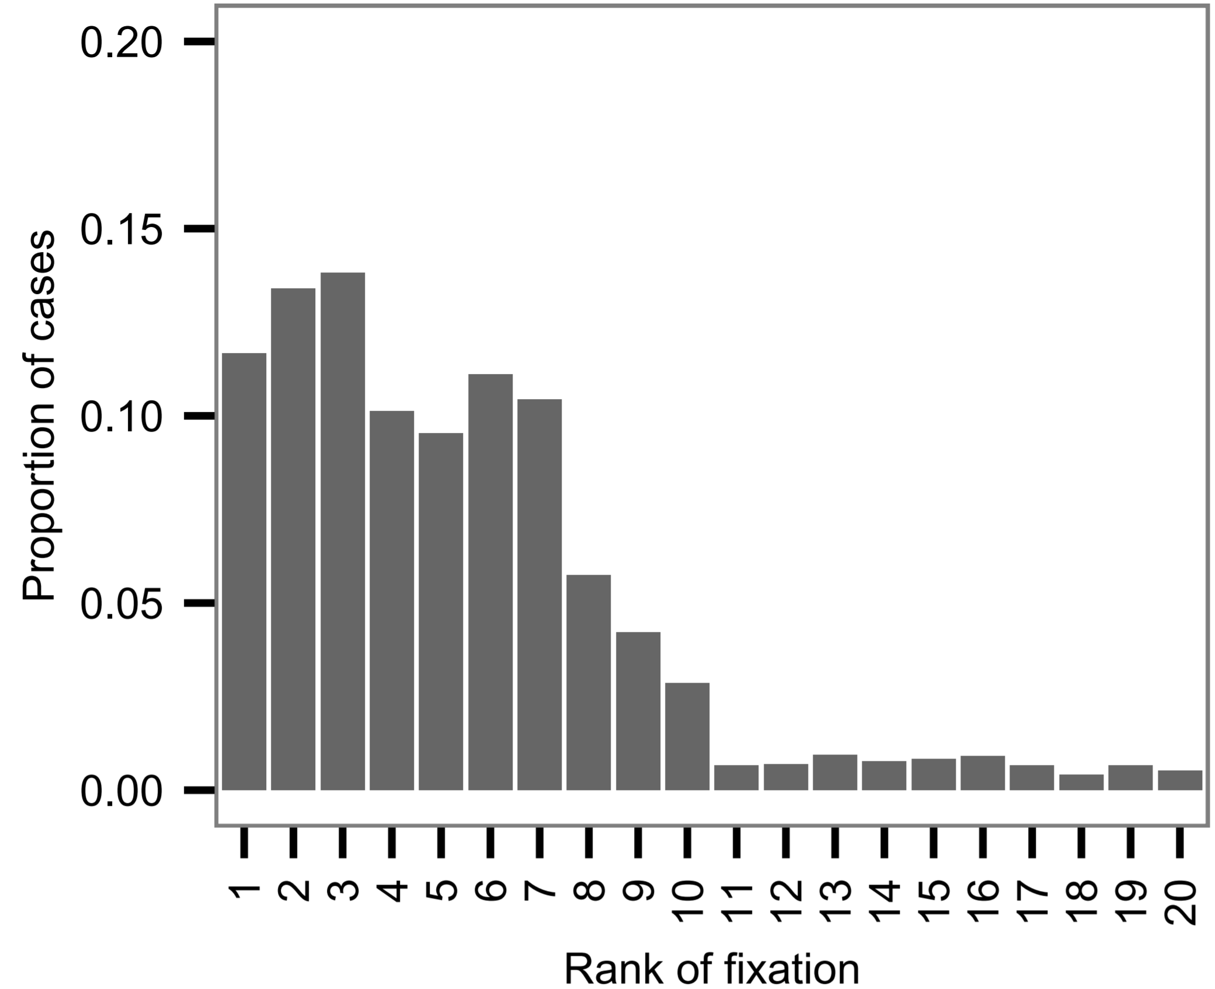
Thomas et al., AIRS 2013
Notes:
Eye tracking of 34 people, 10-item SERP, seven links above the fold. Mostly top-weighted

Slide 36
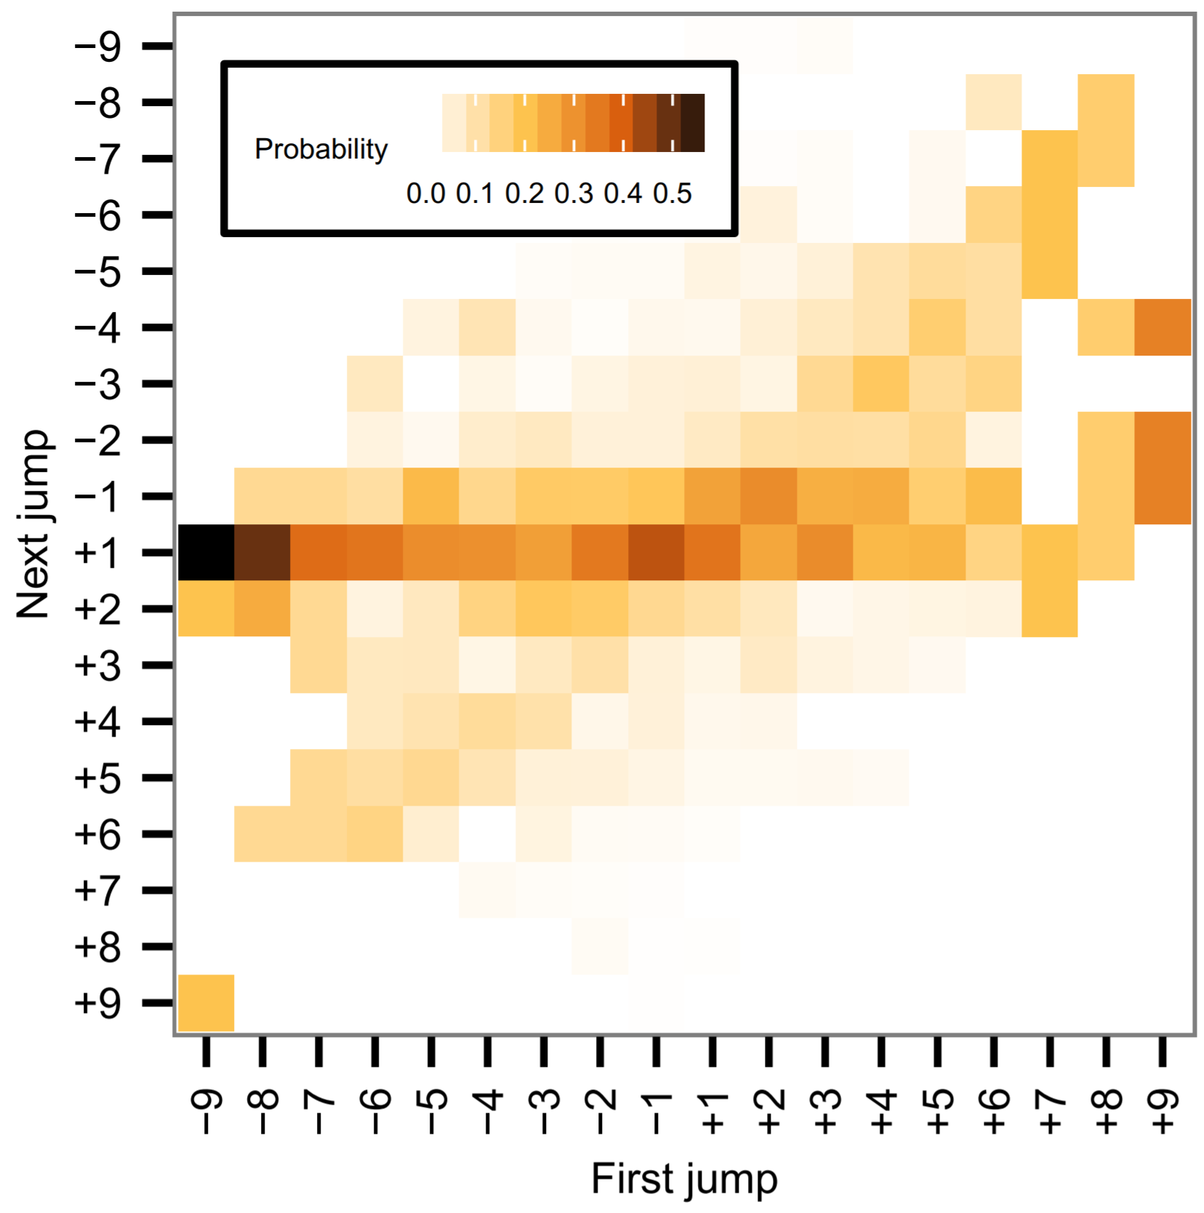
Thomas et al., AIRS 2013
Notes:
Mostly moves are +1 i.e. read down to the next

Slide 37
MS paper showing click rates by rank? (SIGIR??)

Slide 38
Non-decreasing
All else being equal,
C should increase (or stay the same) with depth.
This may reflect the sunk costs fallacy.

Slide 39
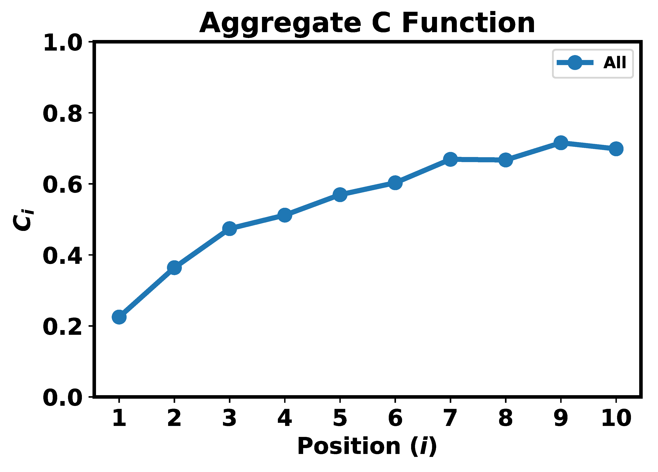

Notes:
Just MLE – the proportion of people observed stopping past this rank
16.4M query impressions on Bing, US English, two weeks
(Although NB we made some strong assumptions about reading order, when there are two columns)

Slide 40
Alistair, is there a similar plot you can show for Seek?

Slide 41
Non-zero, non-one
C should never be exactly 0 nor exactly 1.
People may give up before getting enough;
or may not stop even once they’ve got enough.

Slide 42
Any evidence?

Slide 43
Goal-sensitive
All else being equal,
C is connected to some goal
(we’re more persistent if we want lots of stuff).

Slide 44
Example from early PT/AM/FS work with gaze tracking?
Anything else?

Slide 45
Gain-sensitive
All else being equal,
C decreases as we get gain
(we’re less persistent as we get towards our goal).

Slide 46
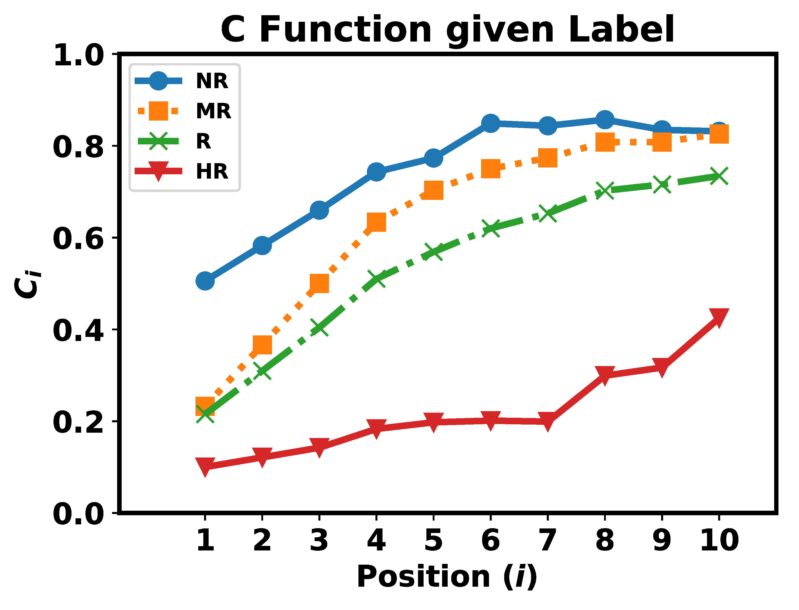
Notes:
Not Rel, Marginally Rel, Rel, Highly Rel (at i alone)
Note that getting more relevance always reduces C

Slide 47
Alistair, is there a similar plot you can show for Seek?
Any better evidence? Sum-of-rel from early work

Slide 48
Cost-sensitive
All else being equal,
C decreases as we incur cost
(we’re less persistent as we take longer).
TO DO c.f. egregious non-rel

Slide 49
Anything to show?

Slide 50
Rate-sensitive
All else being equal,
C is connected to rate of gain
(we’ll persist while we’re getting stuff easily).

Slide 51
Anything to show?

Slide 52
Top-weighted (forced by C/W/L)
Non-decreasing (we have some evidence)
Goal-sensitive
Gain-sensitive (we have some evidence)
Cost-sensitive
Rate-sensitive

Slide 53
Can we have all the nice things?
 | P | sDCG | RR | RBP | AP | …?... | INST | IFT
Top-weighted | ✔ | ✔ | ✔ | ✔ | ✔ |  | ✔ | ✔
Non-decreasing | ❌ | check | ❌ | ✔ | check |  | ✔ | ✔
Goal-sensitive | ❌ | ❌ | ❌ | ❌ | check |  | ✔ | ✔
Adaptive | ❌ | ❌ | ✔ | ❌ | check |  | ✔ | ✔
Rate-sensitive | ❌ | ❌ | ❌ | ❌ | ❌ |  | sorta | ✔
Notes:
TO DO fix row names ; COST?

Slide 54
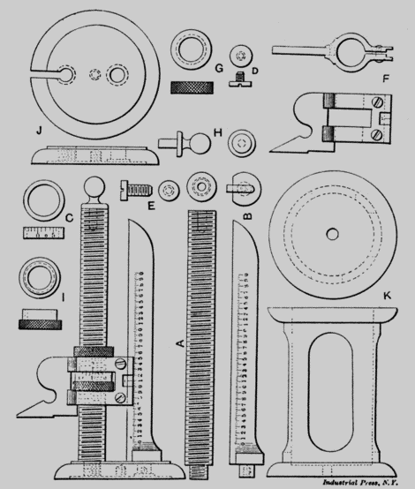
Measuring the measures
Notes:
So now we’ve got a bunch of models defining a bunch of measures or metrics
All in the same framework, all with coherent units.
But so what? How do we choose? What makes a metric “better”?

Slide 55
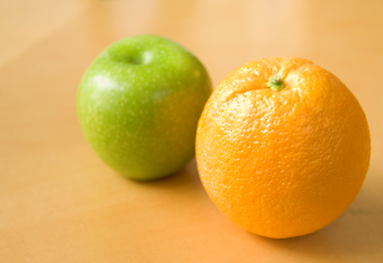
Measuring the measures
Qui judicas judices?
Notes:
So now we’ve got a bunch of models defining a bunch of measures or metrics
All in the same framework, all with coherent units.
But so what? How do we choose? What makes a metric “better”?

Slide 56
So what, can we (how do we) show one model/metric (they're the same) is better/worse than another? Can we measure the difference?
(this is Alfan/Alistair, Leif/Paul/Nick for example; also Emine/Nick and doubtless others)
rhetoric
theory
alignment with observations of behaviour
other nice properties e.g. sensitivity, simplicity, ...
how complex do we need to be in our models?

Slide 57
How to compare?
Satisfaction?
Observable behaviour!
Notes:
Sensitivity
Cost to compute…
But: validity, predicting something in the real world

Slide 58

Reflecting observable behaviour: 1
Stopping
Accumulated utility
Accumulated cost
$$\text{Likelihood} \text{of} \text{stopping} \text{at} i$$
$$=L_{i}$$

Slide 59


Model / measure | Mean likelihood
P@1 | 0.49
P@5 | 0.00
P@10 | 0.00
SDCG@1 | 0.49
SDCG@5 | 0.33
SDCG@10 | 0.33
RR | 0.36
RBP, φ=0.1 | 0.44
RBP, φ=0.7 | 0.16
INST, T=1 | 0.34
INST, T=2 | 0.21
IFT | 0.76
Notes:
Both tuned and commonly used
Shallow – more likely
But not always best, e.g. P@1 is .49 so 1/2 the time people stop lower

Slide 60

Reflecting observable behaviour: 2
Stopping
Accumulated utility
Accumulated cost
$$\text{Expected} \text{total} \text{utility}=\sum_{i}{\left(L_{i}\sum_{j=1}^{i}{r_{i}}\right)}$$
Notes:
Look at …… impressions, look at clicked results and relevance labels for these, add up over a session
Report MAE

Slide 61
Model / measure | MAE (utility)
P@1 | 0.32
P@5 | 0.47
P@10 | 0.65
SDCG@1 | 0.32
SDCG@5 | 0.26
SDCG@10 | 0.38
RR | 0.36
RBP, φ=0.1 | 0.32
RBP, φ=0.7 | 0.38
INST, T=1 | 0.34
INST, T=2 | 0.36
IFT | 0.16

Slide 62
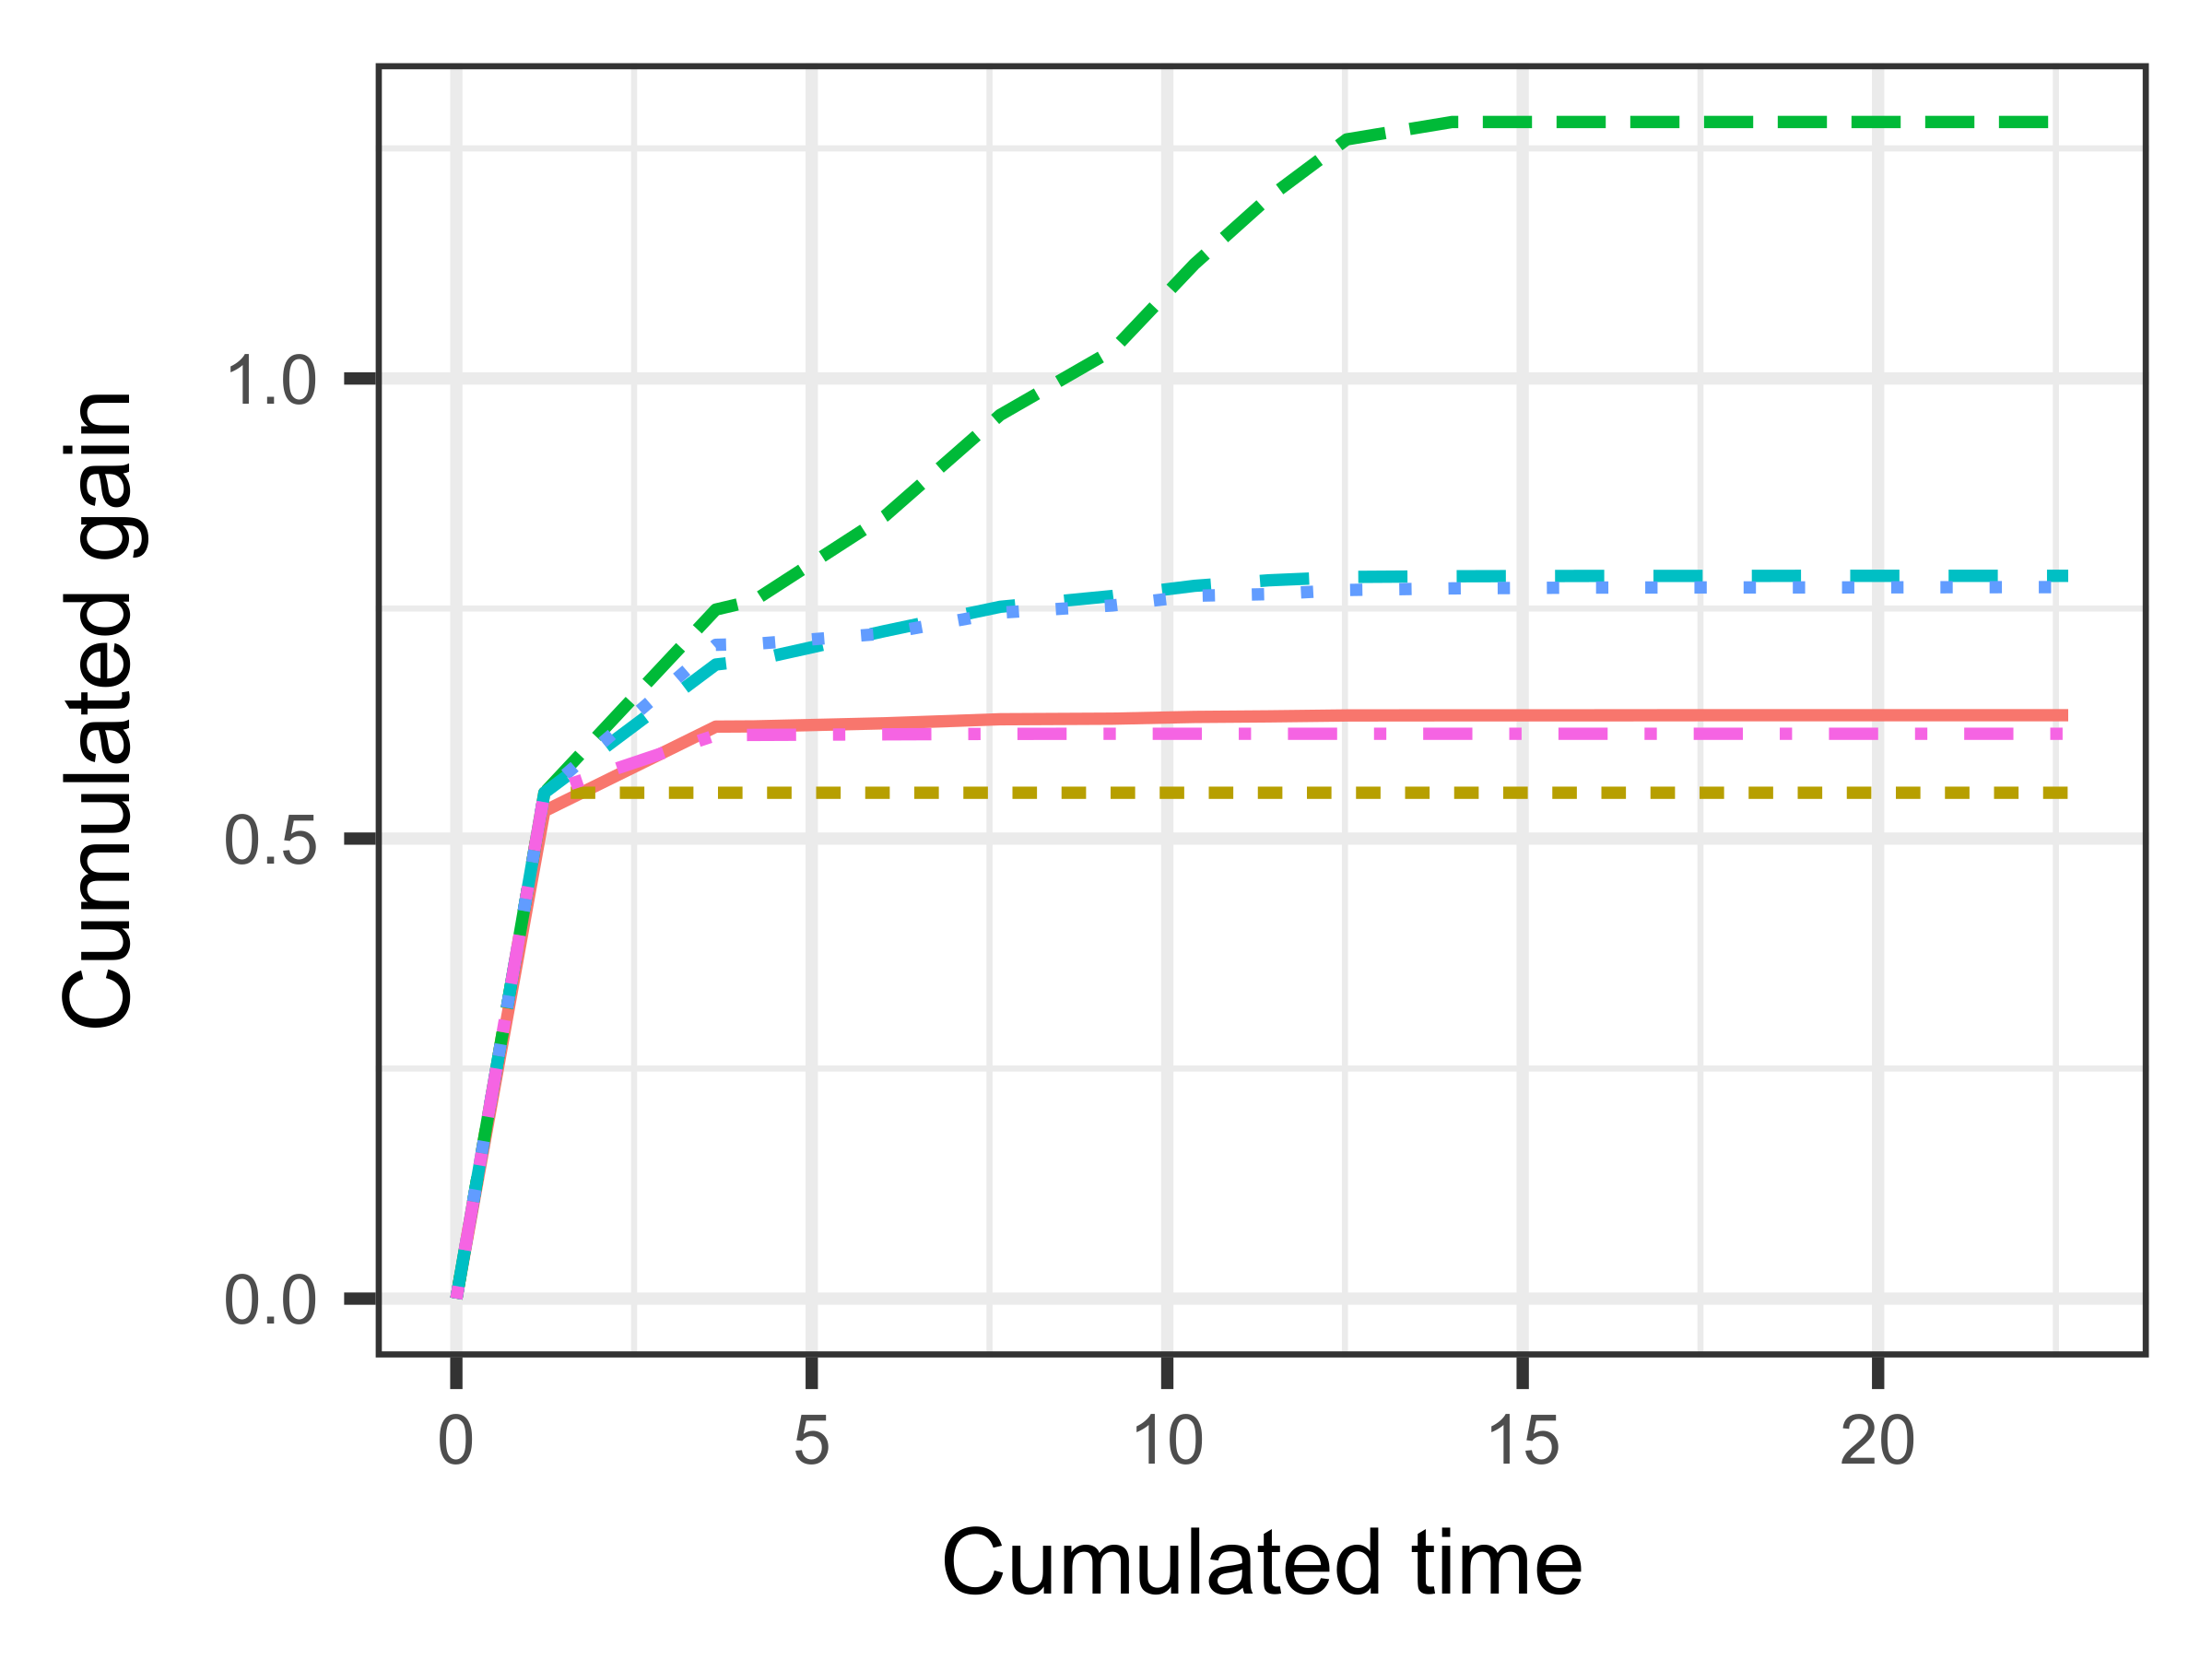
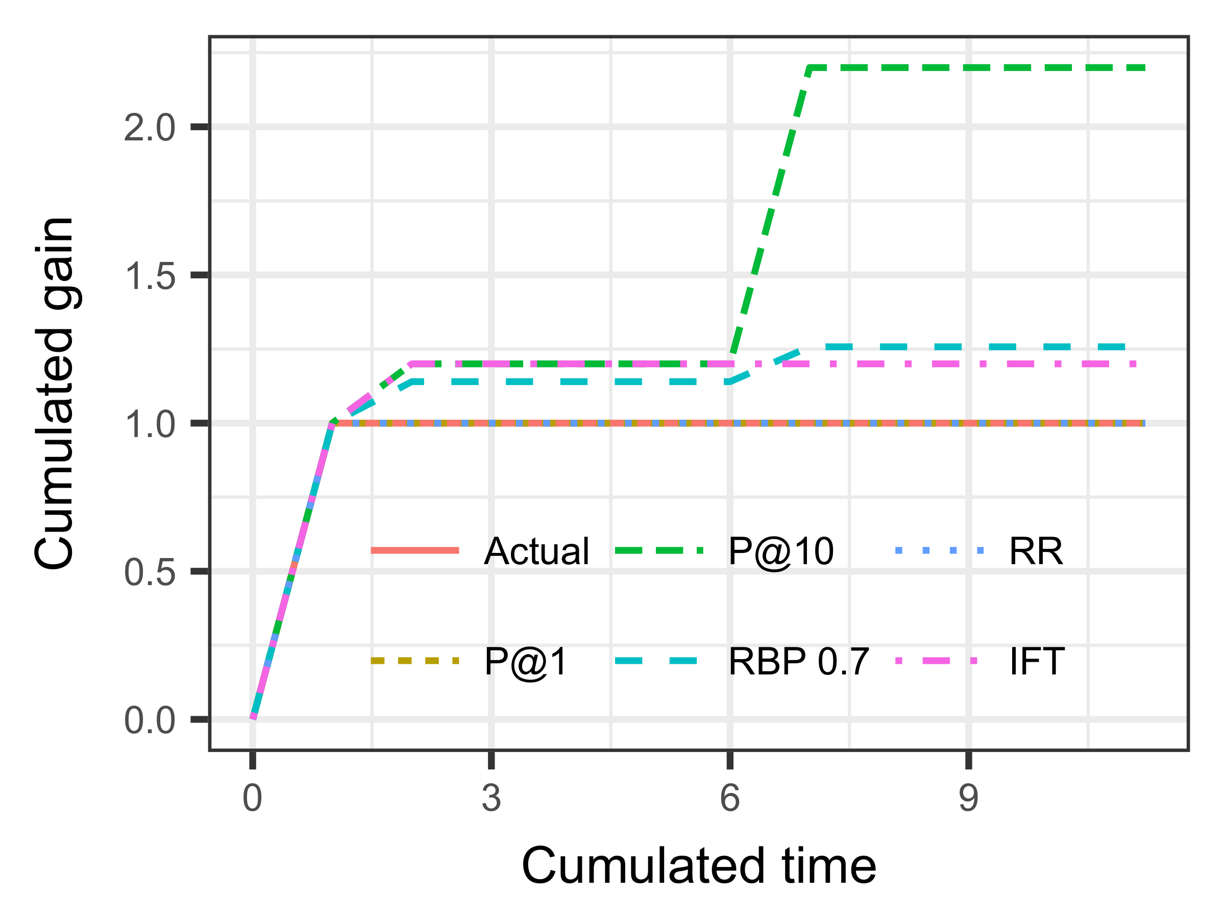


P@10 way too high
RBP, RR both too high
IFT does well
P@1 a bit low
Average over 5000 impressions
Notes:
Average over 5000 impressions, starting to look good

Slide 63

Reflecting observable behaviour: 3
Stopping
Accumulated utility
Accumulated cost
$$\text{Expected} \text{total} \text{cost}=\sum_{i}{\left(L_{i}\sum_{j=1}^{i}{k_{i}}\right)}$$

Slide 64
Model / measure | MAE (cost)
P@1 | 0.91
P@5 | 4.31
P@10 | 7.73
SDCG@1 | 0.91
SDCG@5 | 3.10
SDCG@10 | 4.98
RR | 1.71
RBP, φ=0.1 | 1.03
RBP, φ=0.7 | 2.60
INST, T=1 | 1.44
INST, T=2 | 2.16
IFT | 0.63

